Slide 1

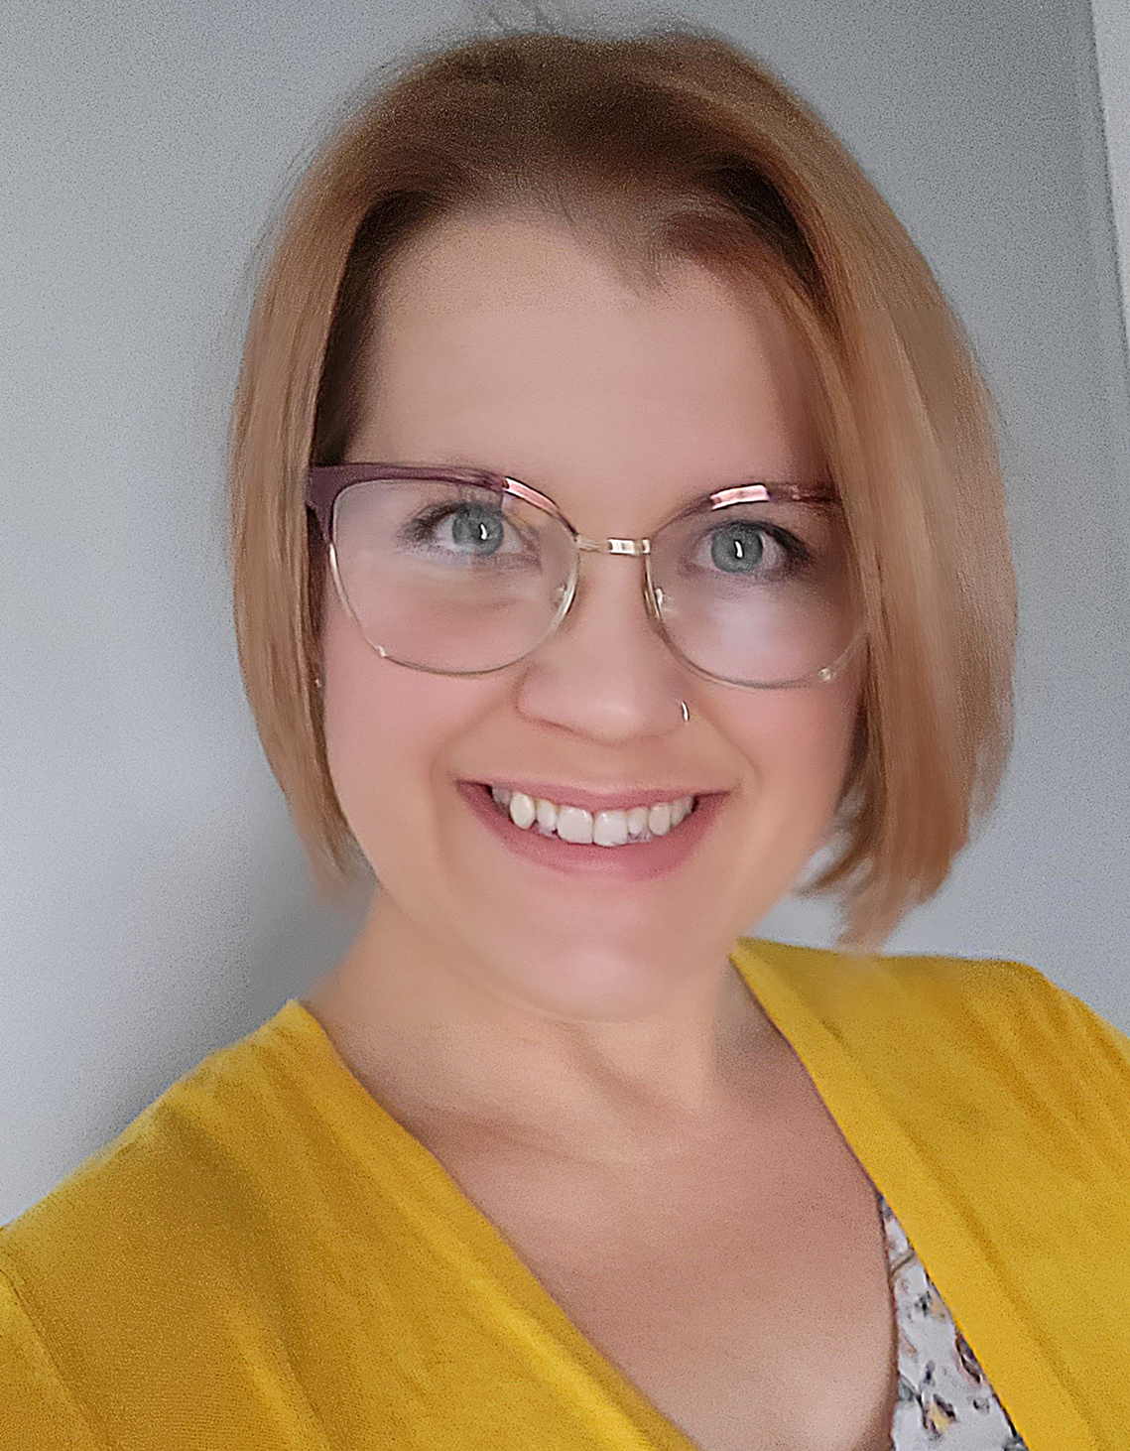

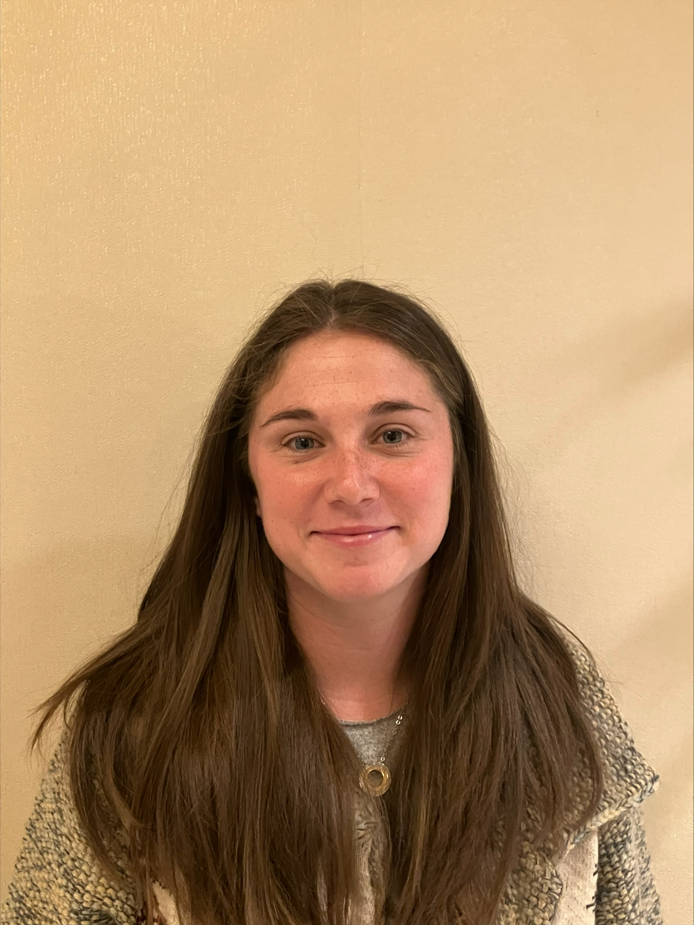
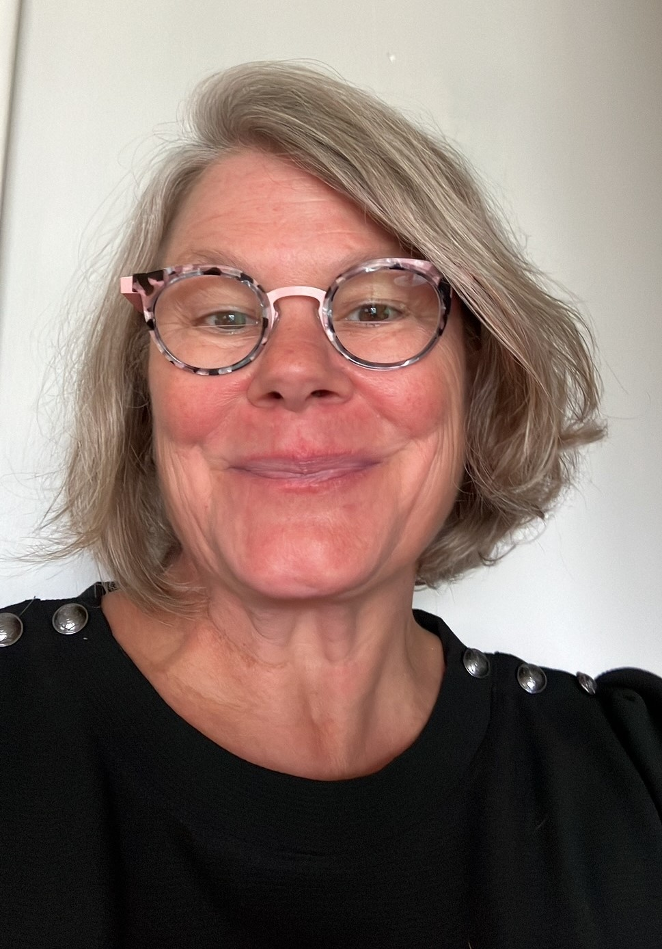
Introductions
Blended Age Mental Health Consultants
Shannon Melanson
Southeast Region
Lauren Walter
North Central Region
Jennifer Poole
South Central Region
Cory Wurst
Western Region
School Age Childcare Technical Assistant Specialist
Betsy Saatman

Slide 2
Youth Behavior Reflection Support Tool
Presented by
The Pennsylvania Key
Notes:
1 min- Betsy
If you’d like a digital copy of this from, scan the QR code on the next slide

Slide 3

Today’s Agenda:
Introduce the Youth Behavior Reflection Support Tool
Model how to use the tool and self-reflect
Practice using the tool in small groups
Large group discussion
Questions and Answers
Notes:
1 minute- Betsy

Slide 4
What challenging behaviors are you seeing in your school age program?
Notes:
1 minute- Betsy

Slide 5
Confidentiality
As a Reminder:
In respect of the child, family, and program staff, the information collected is to be handled in a professional manner and the commitment of confidentiality will be followed.
This means none of the information will be shared externally outside of stated partners above without the permissions of the family and program.
Notes:
2 minutes- Lauren

Slide 6

Development History of the Youth Behavior Reflection Support Tool
The Youth Behavior Reflection Support Tool was created for suspension expulsion prevention.
Field Voice
SAC Leadership
Blended Age Mental Health Consultant (BAMHC) and Infant Early Childhood Mental Health Consultant (IECMH)
IECMH Leadership
Today
Notes:
1 minute- Betsy

Slide 7

Tool Walk Through
We will briefly show you the Youth Behavior Reflection Support Tool and discuss the different sections.
Notes:
15 minutes- Lauren

Slide 8
The Art of Reflection:
The Youth Behavior Reflection Support Tool was developed with questions that should guide self-reflection and program-wide reflection. It is designed with open-ended questions to encourage reflection.
As a support/coach/director, It will be important to evaluate the comfort of the program you are working with and open doors to the art of reflection.
Program staff should use the tool to evaluate what is happening in a non-judgmental, open-ended, and supportive manner.
“We do not learn from experience…we learn from reflecting on experience.” – John Dewey
Notes:
1 minute- Betsy

Slide 9
Flexible Approaches
There are three options for programs to approach how they would like to use the Youth Behavior Reflection Support Tool.
Idea 1: Read all the questions. Reflect, observe, and then fill out as many questions as possible.
Idea 2: Read one bolded section at a time. Reflect, observe, and fill out as many questions as possible. Then move to the next bolded section.
Idea 3: Seek out support to fill out this tool, talk through discoveries, and create strategies. This can be internal support (Director, Supervisor, peer) or external support (your Keystone STARS Quality Coach, your Program Quality Assessor, Blended Age Mental Health Consultants, or SAC Specialist betsaa@pakeys.org).
Notes:
3 minutes- Lauren

Slide 10
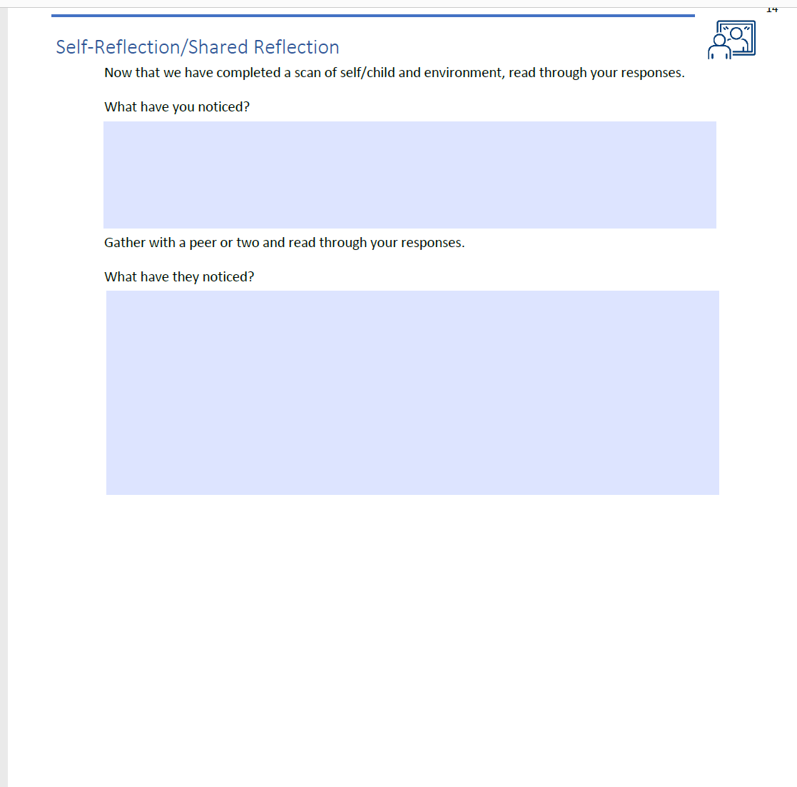
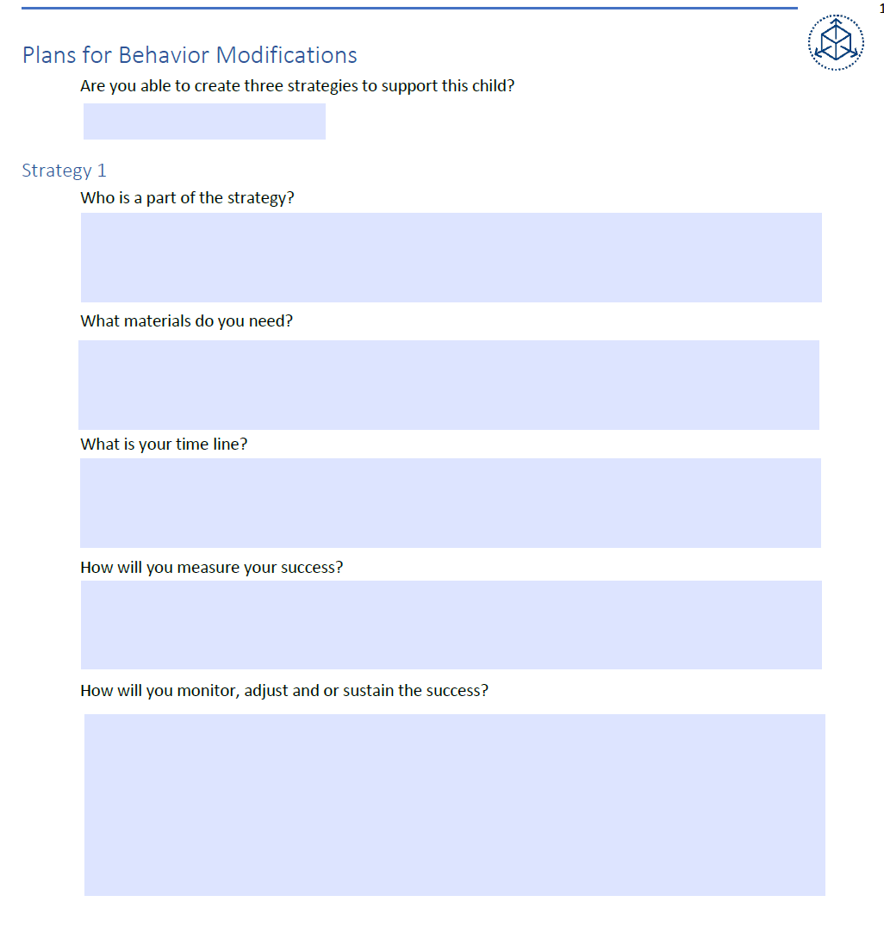
Tool in Action!
Notes:
10 Minutes- Lauren, Betsy, and ??
Model situation with homework and model how to create strategy

Slide 11
Practice using the tool
In small groups we will do the following:
  Step 1. Create a local group of three
  Step 2. Pick a scenario
  Step 3. Read through the scenario independently
  Step 4. Scan through the tool on your own
  Step 5. Work together to determine which sections would help you find the meaning behind the behaviors
  Step 6. Complete the sections as a group
  Step 7. Be prepared to share discoveries
Notes:
15 minutes

Slide 12
Discoveries
  What were your discoveries?
  How did you feel using the tool?
  What did you learn about yourself while using the tool?
Notes:
15 minutes

Slide 13

What are our next steps?
The intent of the Youth Behavior Reflection Support Tool is to help programs build awareness of what is going on, and to put a spotlight on areas the program can be adjusted to further support youth’s specific needs.
Remember, self-reflection is key!
Notes:
1 minute – Lauren

Slide 14
When should programs access the Youth Behavior Reflection Support Tool?
Do not wait until it’s too late- share the Youth Behavior Reflection Support Tool before programs might need it.
Programs could be introduced the Youth Behavior Reflection Support Tool at:
  the beginning of the school year
  the beginning of summer camp
  first set of behavior concerns
  when they welcome new enrollments
Entry points are messy and there is not just one perfect time to share the tool
Change the Environment – Change the Behavior
Notes:
2 minutes- Betsy

Slide 15

Feedback
We would love to hear feedback as programs use the Youth Behavior Reflection Support Tool.
  Send feedback to Lauren Walter (lauwal@pakeys.org) or Betsy Saatman (betsaa@pakeys.org)
Notes:
Lauren- 1 minute

Slide 16

Question and Answers
What questions do you have about sharing and using the Youth Behavior Reflection Support Tool with programs?
Notes:
5 minutes- Lauren

Slide 17

For more support, please contact:
School Age Mental Health Consultation
Betsy Saatman
betsaa@pakeys.org
Notes:
1 minute – Lauren

