Slide 1


PELICAN as One
Notes:
Notes:

Slide 2
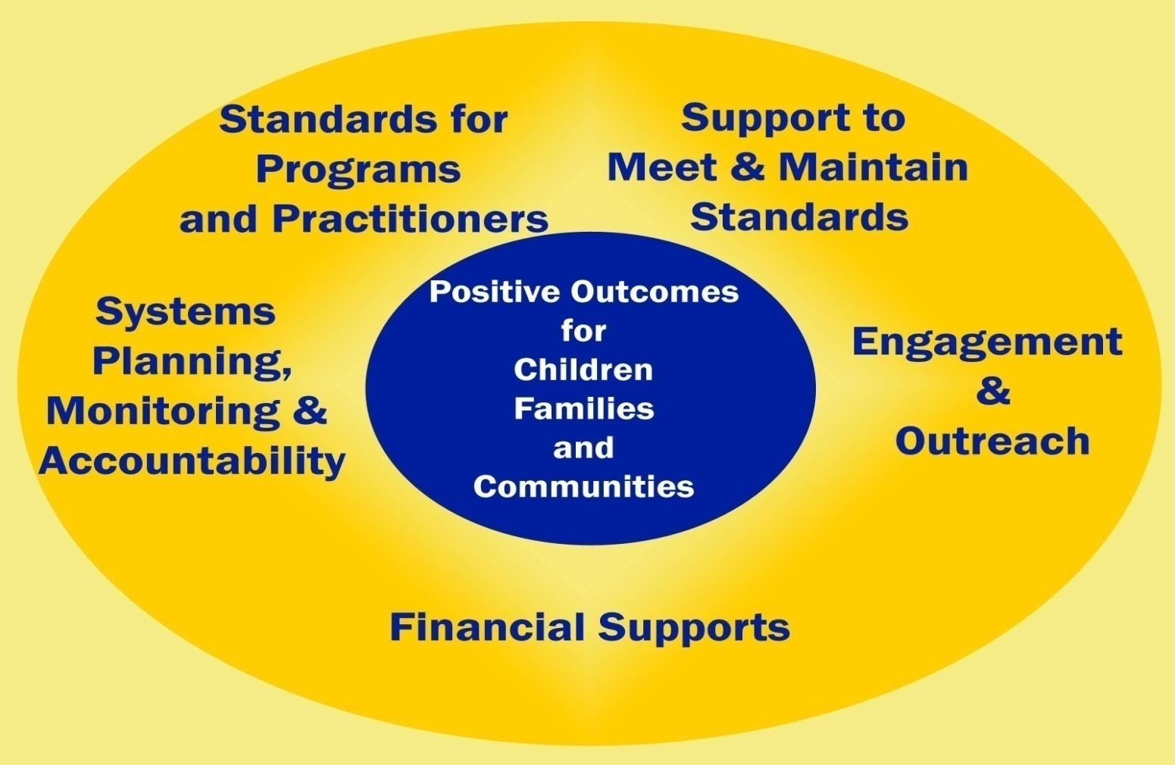
What is OCDEL’s Mission?
The Office of Child Development and Early Learning (OCDEL) promotes opportunities for all Pennsylvania children and families by building systems and providing support that helps to ensure access to high quality child and family services.
Notes:
Notes:

Slide 3




What Does Each OCDEL Bureau Do?
Bureau of Early Intervention Services
Bureau of Early Learning Services
Bureau of Certification Services
Bureau of Subsidized Child Care Services
Responsibilities: Certifies and inspects all child care centers and group homes and registers and inspects family child care homes.
Systems Used: PELICAN Certification & Licensing
Responsibilities: Provides parents with counseling on early learning opportunities in their communities and manages the Child Care Works program. A statewide network of Child Care Information Service (CCIS) agencies is in place to enroll eligible families into subsidized child care.
Systems Used: PELICAN Child Care Works
Responsibilities: Works to ensure that all eligible children from birth to the age of beginner (typically age five), with developmental delays, receive services and supports that maximize their development so they are successful in any early education setting.
Systems Used: PELICAN Early Intervention
Responsibilities: Develops and implements standards for early learning programs and professionals to improve quality of early learning for young children, provide financial supports and technical assistance to support quality and provide programs to strengthen families, reduce risk and increase learning opportunities.
Systems Used: PELICAN Early Learning Network, PELICAN Pre-K Counts, PELICAN Keys to Quality
Notes:
Notes:

Slide 4


Why Does PELICAN Matter?
PELICAN offers a single integrated information system that automates and supports all of Pennsylvania’s early learning and education programs.
Notes:
Notes:

Slide 5
What is PELICAN?
Certification
Child Care Works
Keys to Quality
PA Pre-K Counts
Provider Management
Early Learning Network
Early Intervention
Pennsylvania’s Enterprise to Link Information for Children Across Networks (PELICAN) is the Departments of Public Welfare and Education’s initiative to combine the state’s early learning programs under a single management information system. All early learning services information is managed in PELICAN.
The PELICAN system includes the following:
Notes:
Notes:

Slide 6
What are the Systems That Make Up PELICAN?
Certification
  OCDEL Certification staff use this system to manage the registration and certification process for regulated child care providers – including applications, inspections, certification, complaints, incidents and sanctions. This is the main entry point for regulated child care providers into PELICAN.
Child Care Works
Child Care Information Services (CCIS) office staff use this system to administer the subsidized child care program – including eligibility, enrollments, enrollment schedules and payments.
Keys to Quality
  Regional Key staff and Technical Assistance consultants use this system to administer the Keystone STARS program – including provider management, STARS management, grants management, fiscal allocation and technical assistance management.
PA Pre-K Counts
  OCDEL, PA Key Staff, Preschool Specialists, and agencies participating in Pa Pre-K Counts and Head Start State Supplemental Assistance Program use this system to manage program applications, financial and budget information, classroom and staff information, child and family information, and quality-related functions.
Notes:
Notes:

Slide 7
What are the Systems that Make Up PELICAN?
Early Learning Network
  OCDEL uses this system for gathering information on early learning programs in Pennsylvania and for studying the development of children in those programs. The Early Learning Network combines structural information about the programs, including the quality and experience of staff, with information on the development of children over time.
Early Intervention
OCDEL uses this system to support the administration of the Early Intervention program for infants/toddlers or preschool children who receive Early Intervention services due to a developmental delay or disability. Supports functions related to child evaluation, individual education plans (IEPs) or individual family support plans (IFSPs); service coordination; and payments/claims processing (infants & toddlers only).
Provider Management
  OCDEL uses this system to collect basic demographic data on early learning providers that are not regulated by OCDEL. Examples include Head Start and school-based pre-kindergarten programs.
Notes:
Notes:

Slide 8
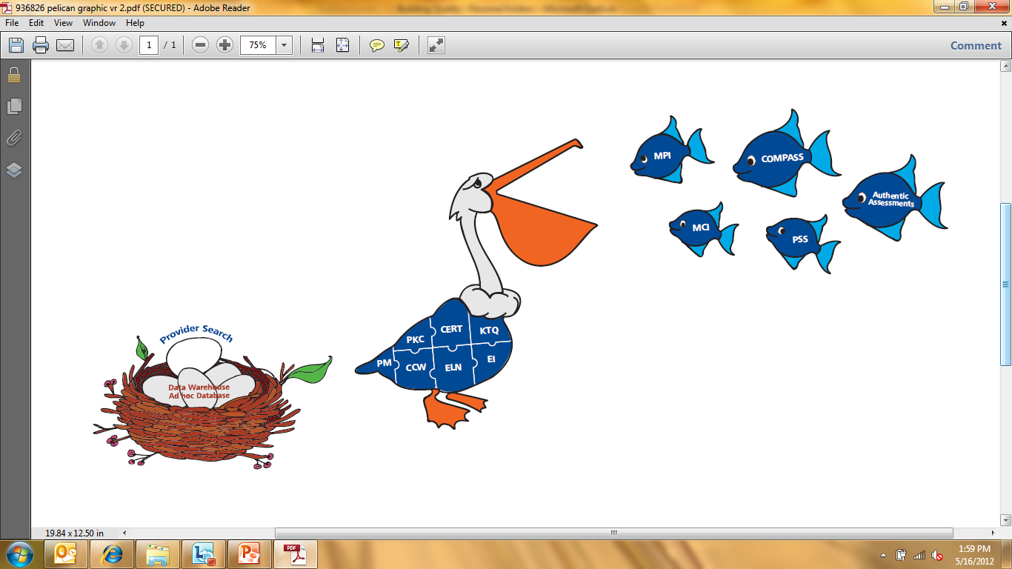
How Do the Systems Work Together?
Notes:
Notes:

Slide 9
How Do the Systems Work Together?
Certification (Cert)
  This system is used to manage applications, inspections, certifications, complaints, incidents and sanctions.
Regulated child care providers begin their experience with PELICAN here, including child care centers, group child care homes and family child care homes.
Once a regulated child care provider is certified in the Certification system, the information is shared with Child Care Works, Keys to Quality and Pre-K Counts.
When a regulated child care provider is closed in Certification, the information is shared with the other PELICAN systems.
When a regulated child care provider receives a sanction, the information is entered into the Certification system.
Primary Users of the System
OCDEL’s Certification Staff
OCDEL Headquarters Staff
Notes:
Notes:

Slide 10
How Do the Systems Work Together?
Provider Management (PM)
  This system is used to collect basic demographic data for providers that are not regulated by OCDEL.
  Early learning providers that are not regulated by OCDEL begin their experience with PELICAN here. Examples include Head Start, licensed nurseries and school-based pre-kindergarten programs.
  When program participation such as Head Start, Pre-K Counts or Licensed Nursery is selected in Provider Management, the information is shared with other PELICAN systems.
Primary Users of the System
OCDEL Headquarters Staff
Notes:
Notes:

Slide 11
How Do the Systems Work Together?
Child Care Works (CCW)
  This system is used to administer the Child Care Works subsidized child care program, supporting subsidy application and intake, eligibility, enrollment, attendance and payment processing.
  Unregulated relative and neighbor providers begin their experience with PELICAN here. The information entered and managed in Child Care Works also can be viewed and searched in Provider Management.
Primary Users of the System
Child Care Information Services (CCIS) Staff
Child Care Providers (Attendance Only)
County Assistance Office Staff (Read Only)
OCDEL Headquarters Staff
Inspector General (Read Only)
Comptroller
Notes:
Notes:

Slide 12
How Do the Systems Work Together?
Keys to Quality (KTQ)
  This system is used to administer the Keystone STARS program – including provider management, STARS management, grants management, fiscal allocation and technical assistance management.
  The Keystone STARS program is open to providers that meet STARS standards, including regulated providers, Head Start and Pre-K Counts providers, school district pre-kindergarten and licensed nursery schools. Four different STARS levels can be entered in the system.
  The STAR level information is shared and used by other systems. For example, Child Care Works calculates provider reimbursement levels based on STAR level, allowing STAR 3 and 4 providers to participate in the Early Learning Network.
Primary Users of the System
Regional Key Staff
STARS Technical Assistance Consultants
Classroom Assessors
OCDEL Headquarters Staff
Notes:
Notes:

Slide 13
How Do the Systems Work Together?
PA Pre-K Counts (PKC)
  This system is used to manage functions related to the PA Pre-K Counts and Head Start State Supplemental Assistance programs, including program applications, financial and budget information, classroom and staff information, child and family information, and quality-related functions.
  The Pre-K Counts program is open to public and private school-based pre-kindergarten programs, Head Start programs and STAR 3 and 4 child care providers. The Head Start State Supplement is open to lead agencies participating in the federal Head Start and Early Head Start programs.
Primary Users of the System
Staff of Head Start, Pre-K Counts
Preschool Specialists
PA Key Staff
OCDEL Headquarters Staff
Notes:
Notes:

Slide 14
How Do the Systems Work Together?
Early Intervention (EI)
  This system is used to support the administration of the Early Intervention program, including functions related to child evaluation, individual education plans (IEPs) or individual family support plans (IFSPs), service coordination and payments/claims processing.
  The Early Intervention program provides services and support to infants/toddlers or preschool children with disabilities or developmental delays.
  When Early Childhood Outcome (ECO) assessments are entered into the Early Intervention system, the outcomes data are automatically saved and available in the Early Learning Network.
Primary Users of the System
Service Coordinators and Teachers
Service Providers
Financial Managers
Program Supervisors and Managers
Commonwealth Reviewers
OCDEL Headquarters Staff
EI
Notes:
Notes:

Slide 15

How Do the Systems Work Together?
Early Learning Network (ELN)
  This system is used to gather information on early learning programs in Pennsylvania and to study the development of children in those programs. The Early Learning Network combines structural information about the programs, including the quality and experience of staff, with information on the development of children over time.
  The Early Learning Network is open to all providers that participate in Pre-K Counts, Head Start State Supplemental Assistance Program, STAR 3 and STAR 4 child care providers and Early Intervention.
  The Early Learning Network receives program, staff and child information from Pre-K Counts, Early Intervention, Keys to Quality and Child Care Works.
Primary Users of the System
Staff of Head Start, Pre-K Counts and Participating STARS Providers
OCDEL Headquarters Staff
Notes:
Notes:

Slide 16
How Do the Systems Work Together?
Provider Self Service (PSS)
  Any early learning provider or program can maintain pieces of their demographic information. Any information that providers or programs enter will be available to the public through PA's online early learning provider search.
  Regulated child care providers can:
    Apply for initial or renewal certificates, which are sent directly to the Certification system for processing.
    Submit Plans of Correction (POCs), which are sent directly to the Certification system for processing.
    Submit their monthly subsidized child care attendance invoices, which are sent directly to the Child Care Works system for processing.
  Federal Head Start providers can use PSS to participate in the State Longitudinal Data System (SLDS).
Notes:
Talking Point: Discuss what providers can and can’t change via PSS. They can change information such as hours of operation, transportation options, languages spoken. They cannot change their name or address, for example.

Slide 17
How Do the Systems Work Together?
Master Provider Index (MPI)
  Provider information is stored here. When a change is made to a provider’s information, the information is shared with the Master Provider Index, for example name and address.
  If another DPW system, using the same provider, makes a change, the information is also sent to the Master Provider Index.
  The Master Provider Index then shares the changes with the appropriate PELICAN system.
  The Master Provider Index is used by many other DPW offices - not just OCDEL and its partners. Offices such as Medical Assistance Programs, Developmental Programs and Long Term Living also use it.
Notes:
Talking Point: In the previous slide we discussed the fact the providers cannot change certain pieces of their information. Those pieces are the pieces stored in MPI. They can change anything that is not stored in MPI.
Talking Point: Third bullet, examples of this include, regulated child care provider changes are shared directly with Cert. Unregulated child care provider changes are shared directly with CCW. However, it is important to note that this is more than just child care providers.

Slide 18
How Do the Systems Work Together?
Master Client Index (MCI)
  Client information is stored here. When a change is made to a client’s information, the information is shared with the Master Client Index. For example, when information is changed for a child served through Child Care Works, the information is shared with the Master Client Index.
  If another system, using the same client, makes a change, the information is also sent to the Master Client Index.
  The Master Client Index sends updated data to the other systems that use the client so that all DPW systems and the Insurance Department's Children's Health Insurance Program have consistent, up-to-date client information.
  The Master Client Index is more than just a system used by PELICAN. It is used by many other offices, including Office of Developmental Programs, Office of Long Term Living and the Children’s Health Insurance Program.
  Additionally, when information is changed in the Master Client Index, alerts regarding the changes are sent to users of the other systems who have the clients in their systems.
Notes:
Notes:

Slide 19
How Do the Systems Work Together?
Commonwealth of Pennsylvania Access to Social Services (COMPASS)
  COMPASS allows the public to apply for various DPW programs, including subsidized child care, cash assistance, Low-Income Home Energy Assistance Program (LIHEAP) and Supplemental Nutrition Assistance Program (SNAP).
  When a citizen applies for subsidized child care, the application is sent directly to the Child Care Works system for processing.
  Redeterminations for subsidy can also be performed using COMPASS and are sent directly to Child Care Works for processing.
  A screening module is available to citizens to help them determine whether they are eligible for programs before applying.
Notes:
Notes:

Slide 20
How Do the Systems Work Together?
Data Warehouse (DW)
  Each PELICAN system has a data warehouse, with the exception of KTQ.
  The data warehouses are populated based on the information that users enter into the respective systems. Data reflects a specific point in time, typically month end.
  The better the data entered in the systems, the better the data that is available for analysis in the data warehouses.
Notes:
Talking Point: The data contained in these are used to report both federally and at the state level. Program analysis, budgeting and long term planning are just some of the activities this data is used for.

Slide 21
How Do the Systems Work Together?
Online Provider Search
  When providers update their demographic information in Provider Self Service, the information is then reflected in any searches that the public performs.
  A provider’s rating in the Keystone STARS program, certificate information, sanctions, waivers and violations are available in the search results.
  Search results can also be sorted by the provider STAR level (highest to lowest).
Notes:
Talking Point: In September the first SIX providers will be sorted by STAR level, after that there will be no sort.

Slide 22
How Do the Systems Work Together?
Future Plans
  OCDEL is considering the following items as it continues its mission of building systems and providing support that helps to ensure access to high quality child and family services:
    Providing a more comprehensive link between educators, programs, children and outcomes, using the PA Key.
    Creating a provider management tool to allow providers to see how their programs support the children they serve.
    Introducing new technologies and determining how to leverage smart phones, mobile apps and social media.
Notes:
Notes:

Slide 23
The PELICAN Story is Complete!
Notes:
Notes:

Slide 24


What are People Saying about PELICAN?
“ELN is able to put child developmental outcomes in context, which allows for more informed improvement strategies.”
“Pelican Keys to Quality is enabling OCDEL to collect and analyze program data, as well as more effectively manage the Keystone STARS program in an extraordinary manner that continues to place Pennsylvania as a national role model for Continuous Quality Improvement programs in early
childhood care and education.”
“The improvements realized through Certification save time and allow certification staff to focus on what is of primary importance – ensuring the health and safe care of children in child care facilities.”
Notes:
Notes:

Slide 25
Where Can You Get More Information?
Use the following links to obtain additional and more detailed information on the topics reviewed in this presentation:
Topics | Link
COMPASS | https://www.humanservices.state.pa.us/compass.web/CMHOM.aspx
Online Provider Search | https://www.humanservices.state.pa.us/compass.web/ProviderSearch/pgm/PSWEL.aspx
Provider Self Service | https://www.pelican.state.pa.us/provider
PA Keys Website (PKC and ELN training materials) | http://www.pakeys.org/pages/get.aspx?page=home
PELICAN Learning Management System (Cert and KTQ training materials) | http://www.humanservices-r.state.pa.us/CCMISLMS/pgm/asp/login/login.asp?refpage=/CCMISLMS/default.asp
Notes:
Notes:

